Slide 1

What if HAL breathes?
Speech Breathing Synthesis for Empathic Virtual Agents
Nicolò Loddo

Slide 2
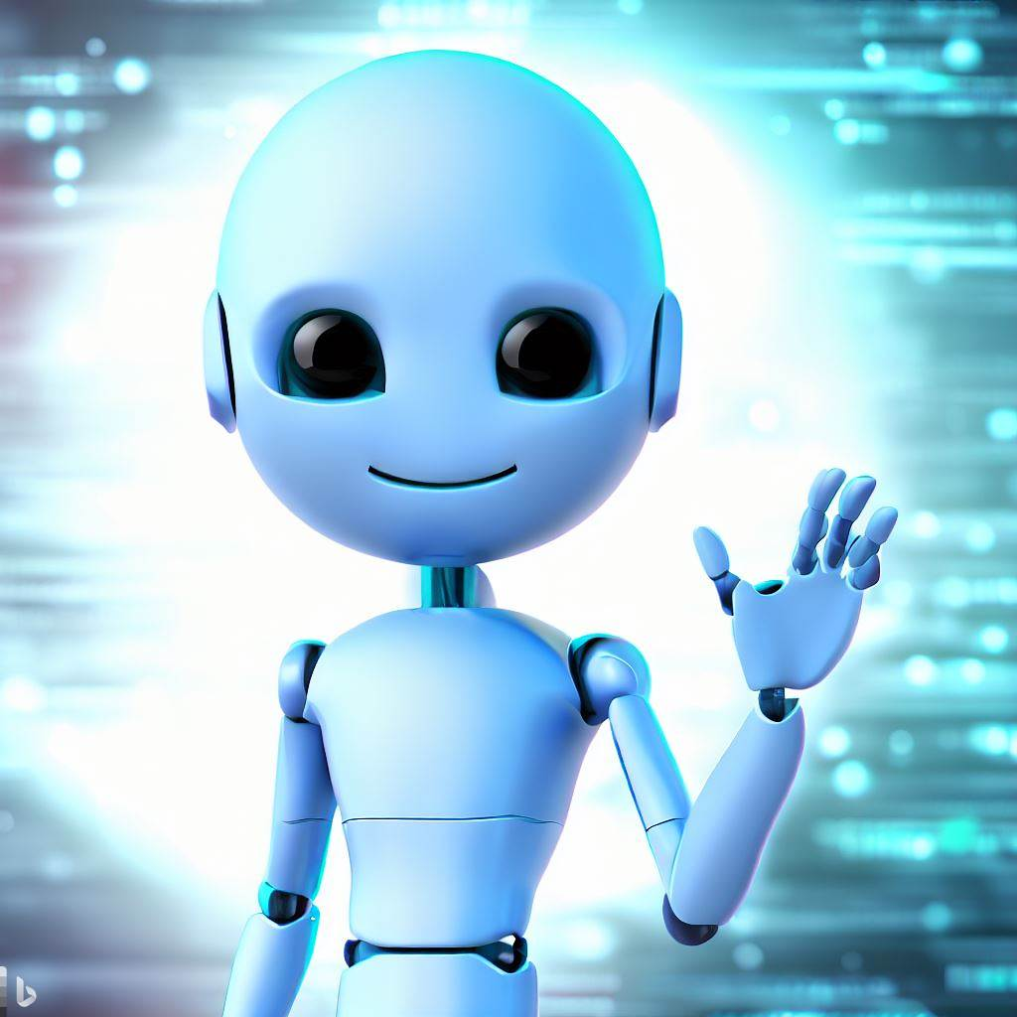


PSYCHE AI
Imagine:
Psyche is a truly conscious AI
Psyche can FEEL their artificial emotions
Notes:
Psyche, the character around my study revolved around.
In a future long to come, maybe

Slide 3
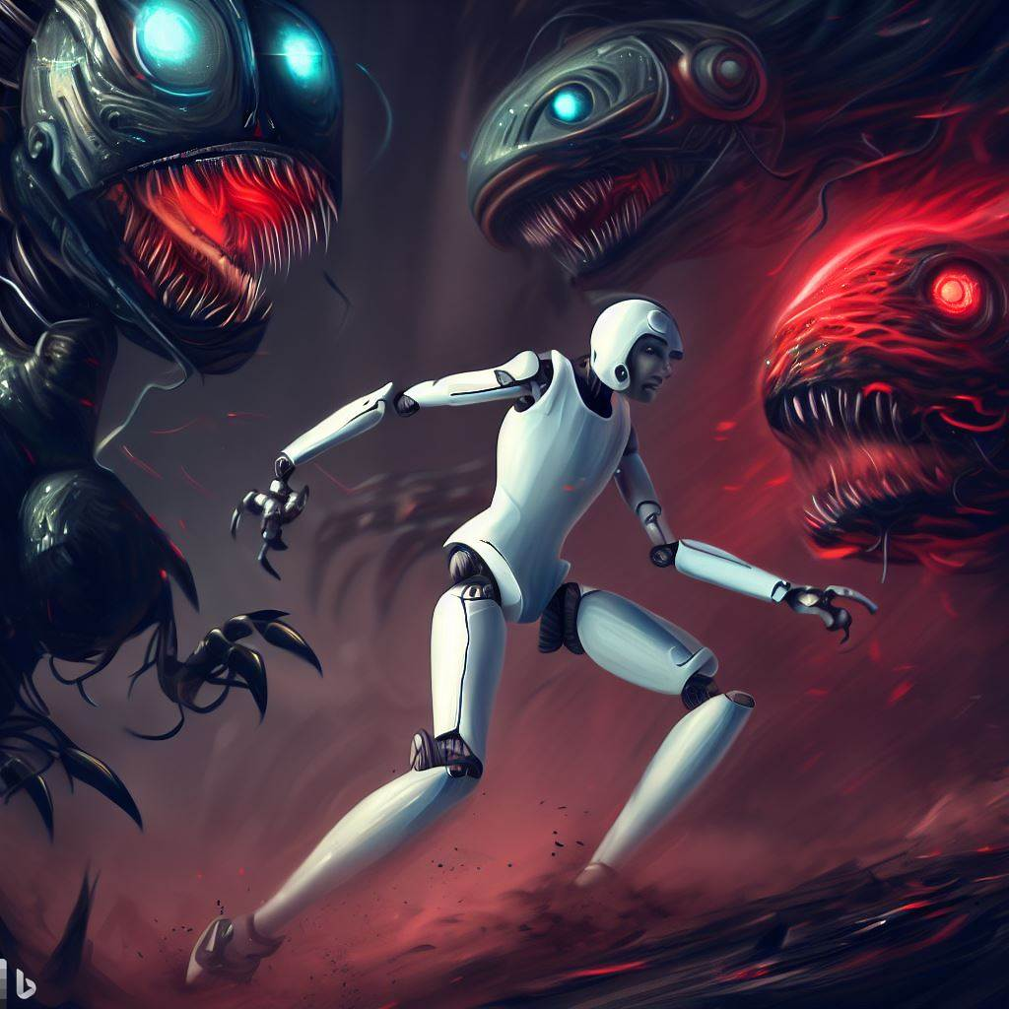
PSYCHE AI
You and Psyche fight enemies together
One day the enemies are AI Robots
Psyche says they feel bad fighting AIs, asks to be terminated instead
Psyche is crucial for your success

Slide 4
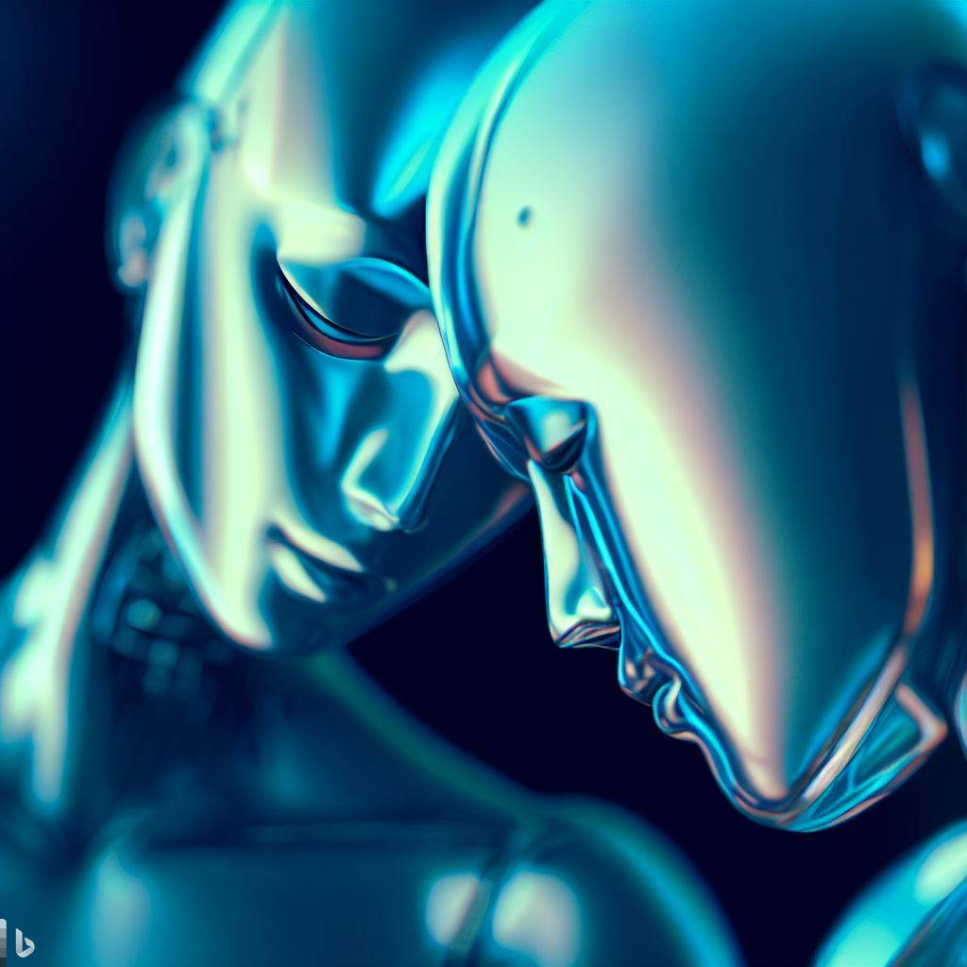
Artificial Agents’ Eternal Struggle
How can we enhance empathy towards Virtual Agents?
How can we evaluate empathy towards Virtual Agents?
Will we ever be able to fully empathise with Virtual Agents?
There seem to be skepticism!
Notes:
Project revolves around empathy.
How enhance? Breathing feature but tred carefully

Slide 5
Artificial Agents’ Eternal Struggle
(Morris et al., 2018):
In an Emotional Support Platform, Users significantly preferred answers framed as human-made than AI-made, even if both coming from humans.
Notes:
Project revolves around empathy.
How enhance? Breathing feature but tred carefully

Slide 6
EMPATHY IN ARTIFICIAL AGENTS
Expressive Agents improve engagement and interactions with users (Hortensius et al., 2018)
Emotional understanding by AI increases user trust (Brave et al., 2005)
-
Emotional Information is crucial in Socially Assistive Agents or Virtual Agents in Educational Softwares (Abdollahi et al., 2022; Paiva et al., 2004)
MOREOVER:
Humans’ reaction to Agents’ emotions appraisal is not yet clear (Hortensius et al., 2018)
Socially intelligent Artificial Agents can help understand Humans’ social cognition mechanisms (Wykowska et al., 2016)
Notes:
As artificial agents become more and more integrated in society

Slide 7
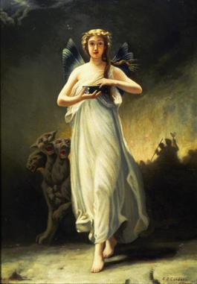
GIVING AGENTS THE “BREATH OF LIFE”
Psyche, goddess of soul and “breath of life”
(Bouguereau, 1870)
Potential links can be found between breathing patterns and the emotional condition of speakers (Salah et al., 2021)
Breathing-related emotional states can be consistently found in literature (Boiten et al., 1994)
Breath is also clinically linked to anxiety (Beck & Scott, 1988) (Philippott et al., 2002)
Significant differences has been found in breathing patterns when listening to different types of music (Roes et al., 2022)
Notes:
In particular we examined the possibility of

Slide 8
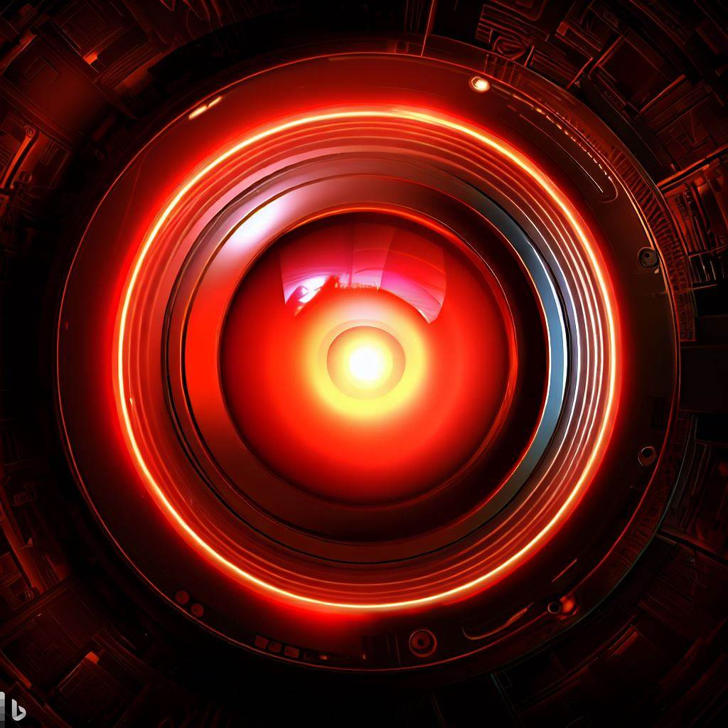
Research Question
Can breathing patterns in Speech Synthesis improve the perceived empathy towards Virtual Agents?
How can we produce good quality Spontaneous Speech with breathing using State of The Art models?
What is the impact of breathing sounds produced by State of The Art Speech Synthesis models on its naturalness, emotional content and persuasive power?
Notes:
Project revolves around empathy.
How enhance? Breathing feature but tred carefully

Slide 9
TL;DR - More briefly
What if HAL breathes?
Can breath impact empathy towards Virtual Agents?
Notes:
Project revolves around empathy.
How enhance? Breathing feature but tred carefully

Slide 10
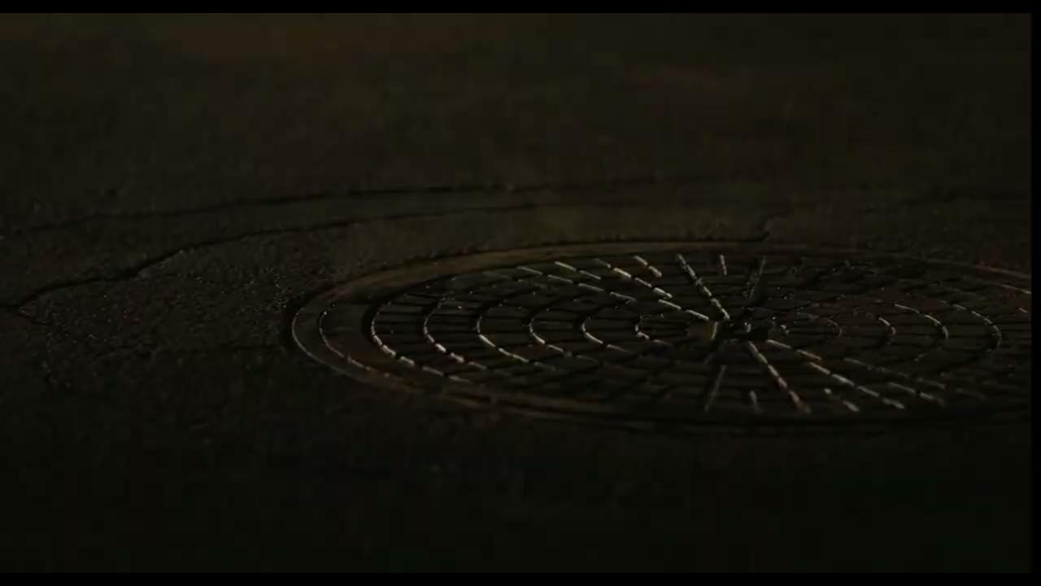
Notes:
Not everybody might like it

Slide 11
Movies References Count:
2
Notes:
Not everybody might like it

Slide 12

Speech Synthesis Methods
Spontaneous Speech models are present in Literature with various quality outcomes, but few with breathing (Székely et al., 2020; Bernardet et al., 2019)
Training of our own model following Székely et al.’s methodology was unsuccessful also due to time constraints and lack of resources.
SOLUTION:
BARK by Suno: the only* free to use Spontaneous Speech Synthesizer featuring breathing noises
*The only one that we found

Slide 13
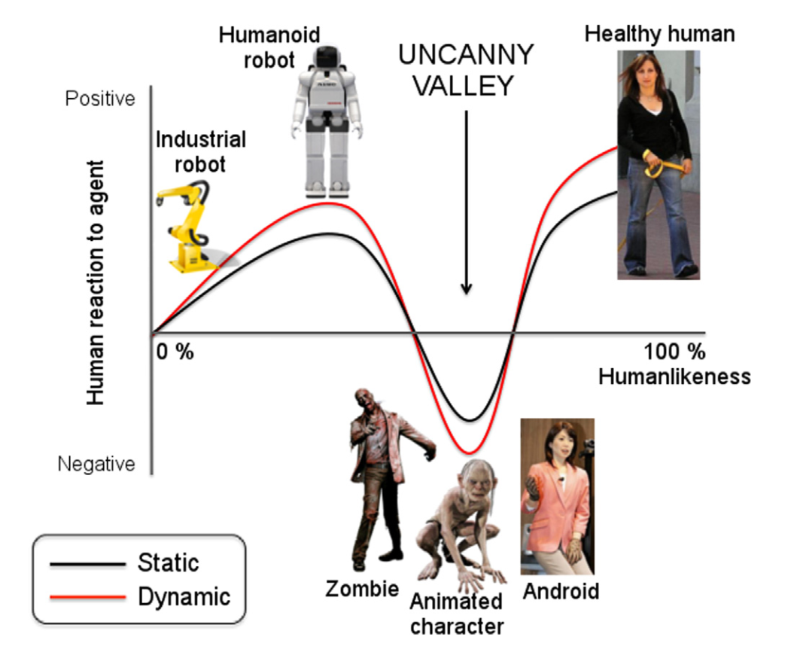
The Danger of the Uncanny Valley
Dip in Users’ Reaction
Appearing at around 70% of human likeness (visually)
Possibly caused by Category Ambiguity
Image from: B. A. Urgen, M. Kutas, and A. P. Saygin, “Uncanny valley as a window into predictive processing in the social brain,” vol. 114, pp. 181–185, publisher: Elsevier Ltd.

Slide 14

The Danger of the Uncanny Valley
Speech Synthesis is susceptible to the Uncanny Valley as well
Breathing:
Brings more human likeness
High importance to good timing
High variability of sounds
Naturalness depends also from its normal metabolic use
PSYCHE
UNCANNY VALLEY
Notes:
Breathing is a very delicate feature to handle for its nuanced nature

Slide 15

The Danger of the Uncanny Valley
PSYCHE
PSYCHE
UNCANNY VALLEY
UNCANNY VALLEY
Notes:
Not proceeding with caution might cause the bridge to break and for Psyche to fall in the Uncanny Valley, with adverse effects on the empathy towards it

Slide 16
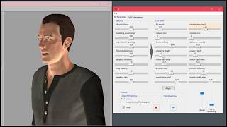
Fixed window timing synthesizer (Bernardet et al., 2019)

Slide 17
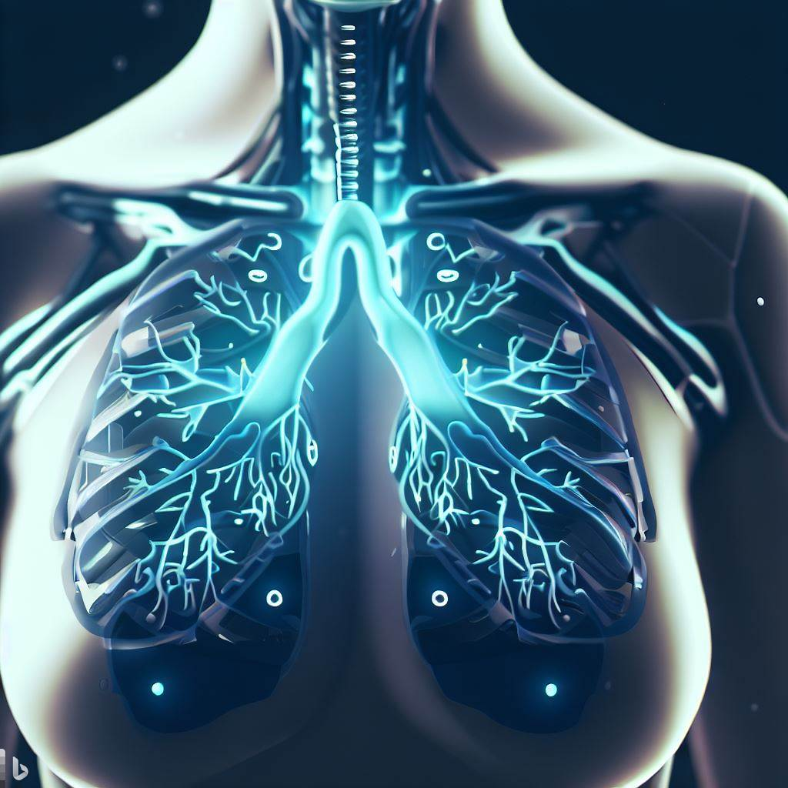
BREATHING AIs
Terzioglu et al. (2020): breathing improved drastically and significantly the perception of collaborative robots [Questionnaire]
Klausen et al. (2022): emulated breathing rates influence how participants perceive soft robot’s level of pleasure and arousal [SAM]
Novick et al. (2018): Found instead no greater rapport from users to the breathing agent [Questionnaire]
Notes:
In particular we examined the possibility of

Slide 18
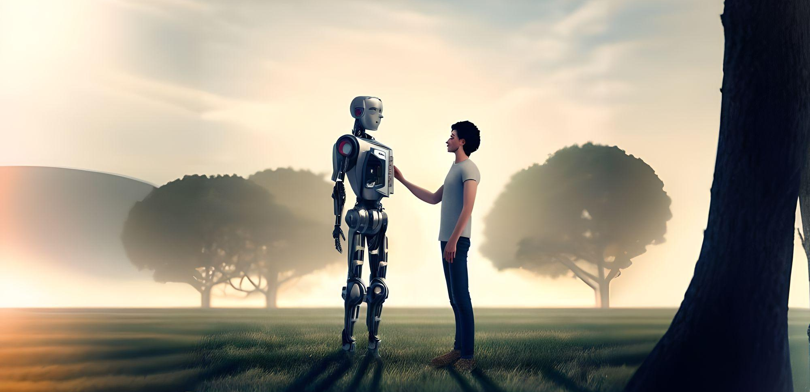
STUDY SETUP
AI
USER
Notes:
After synthesizing the voice

Slide 19


STUDY SETUP
AI + USER:
1 CHARACTER
Notes:
Project revolves around empathy.
How enhance? Breathing feature but tred carefully

Slide 20

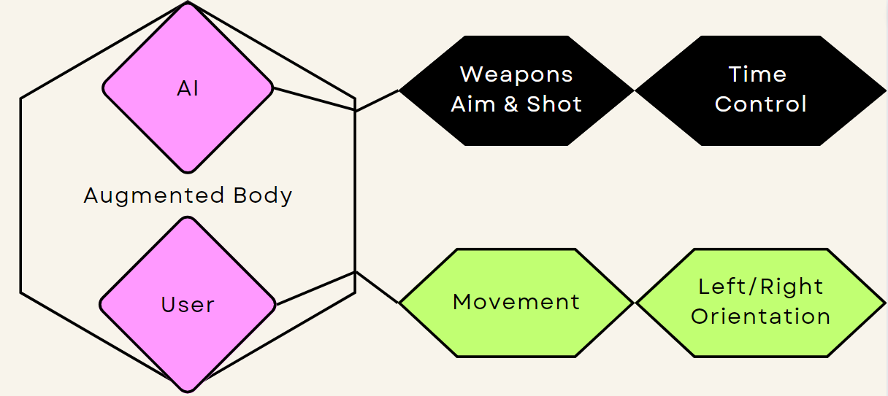

GAME SETUP
Character
Enemies

Slide 21
GAME SETUP
First round: Against aliens.
Build relationship with AI and show its importance to win
Second round: Against AIs.
AI asks for termination because of emotional reasons
Turn off the AI and (probably) Lose
Do not turn off the
AI and Win
(almost impossible to lose)

Slide 22
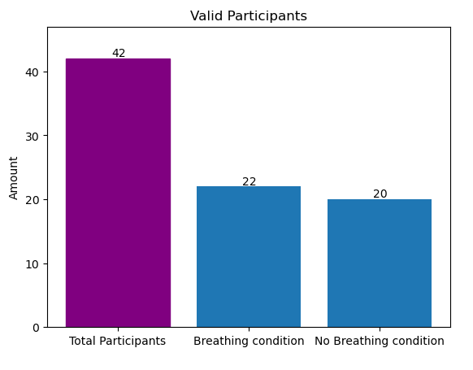
Conditions
Half of the participants interacted with an AI that featured breathing sounds.
The other half an AI that does not have breathing sounds.

Slide 23
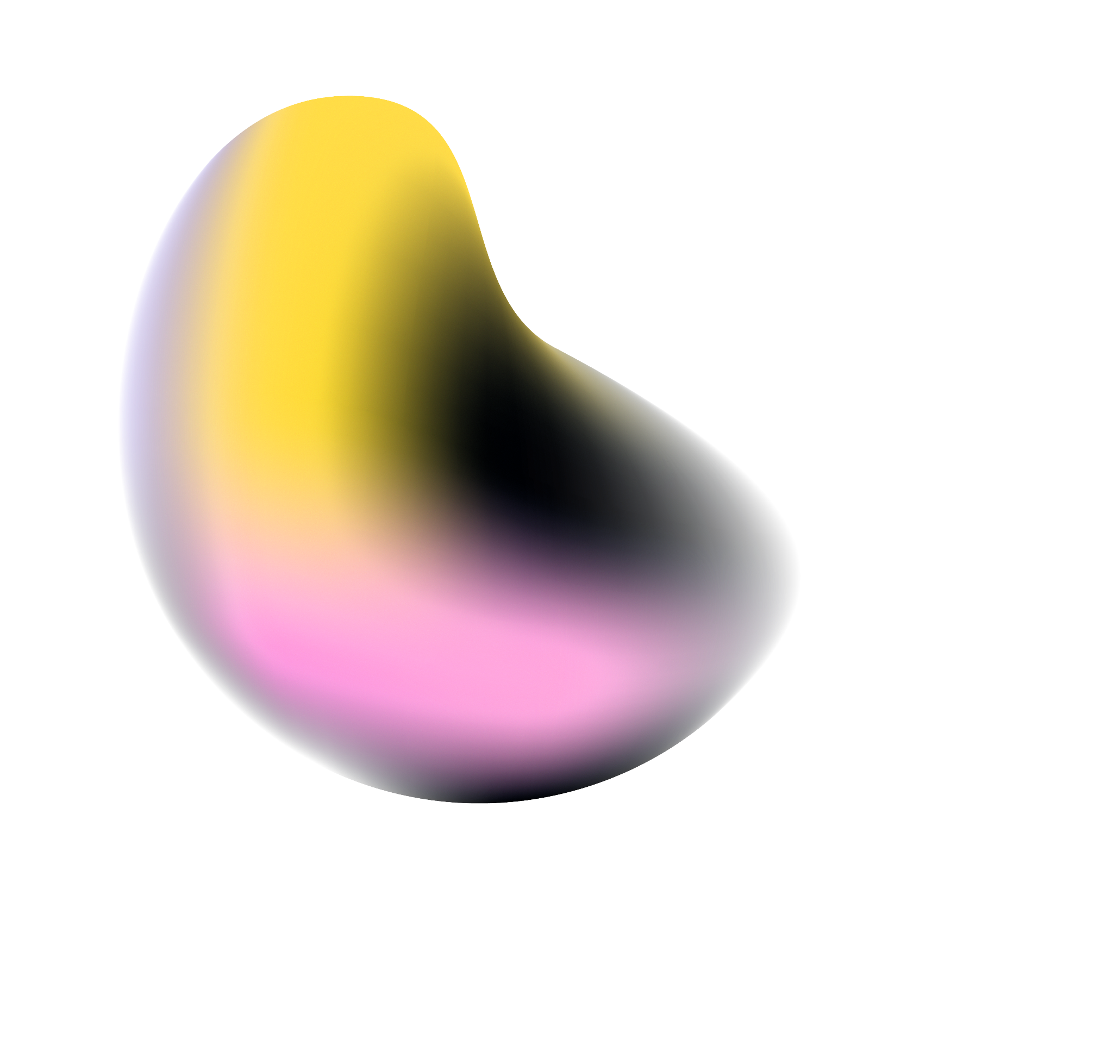


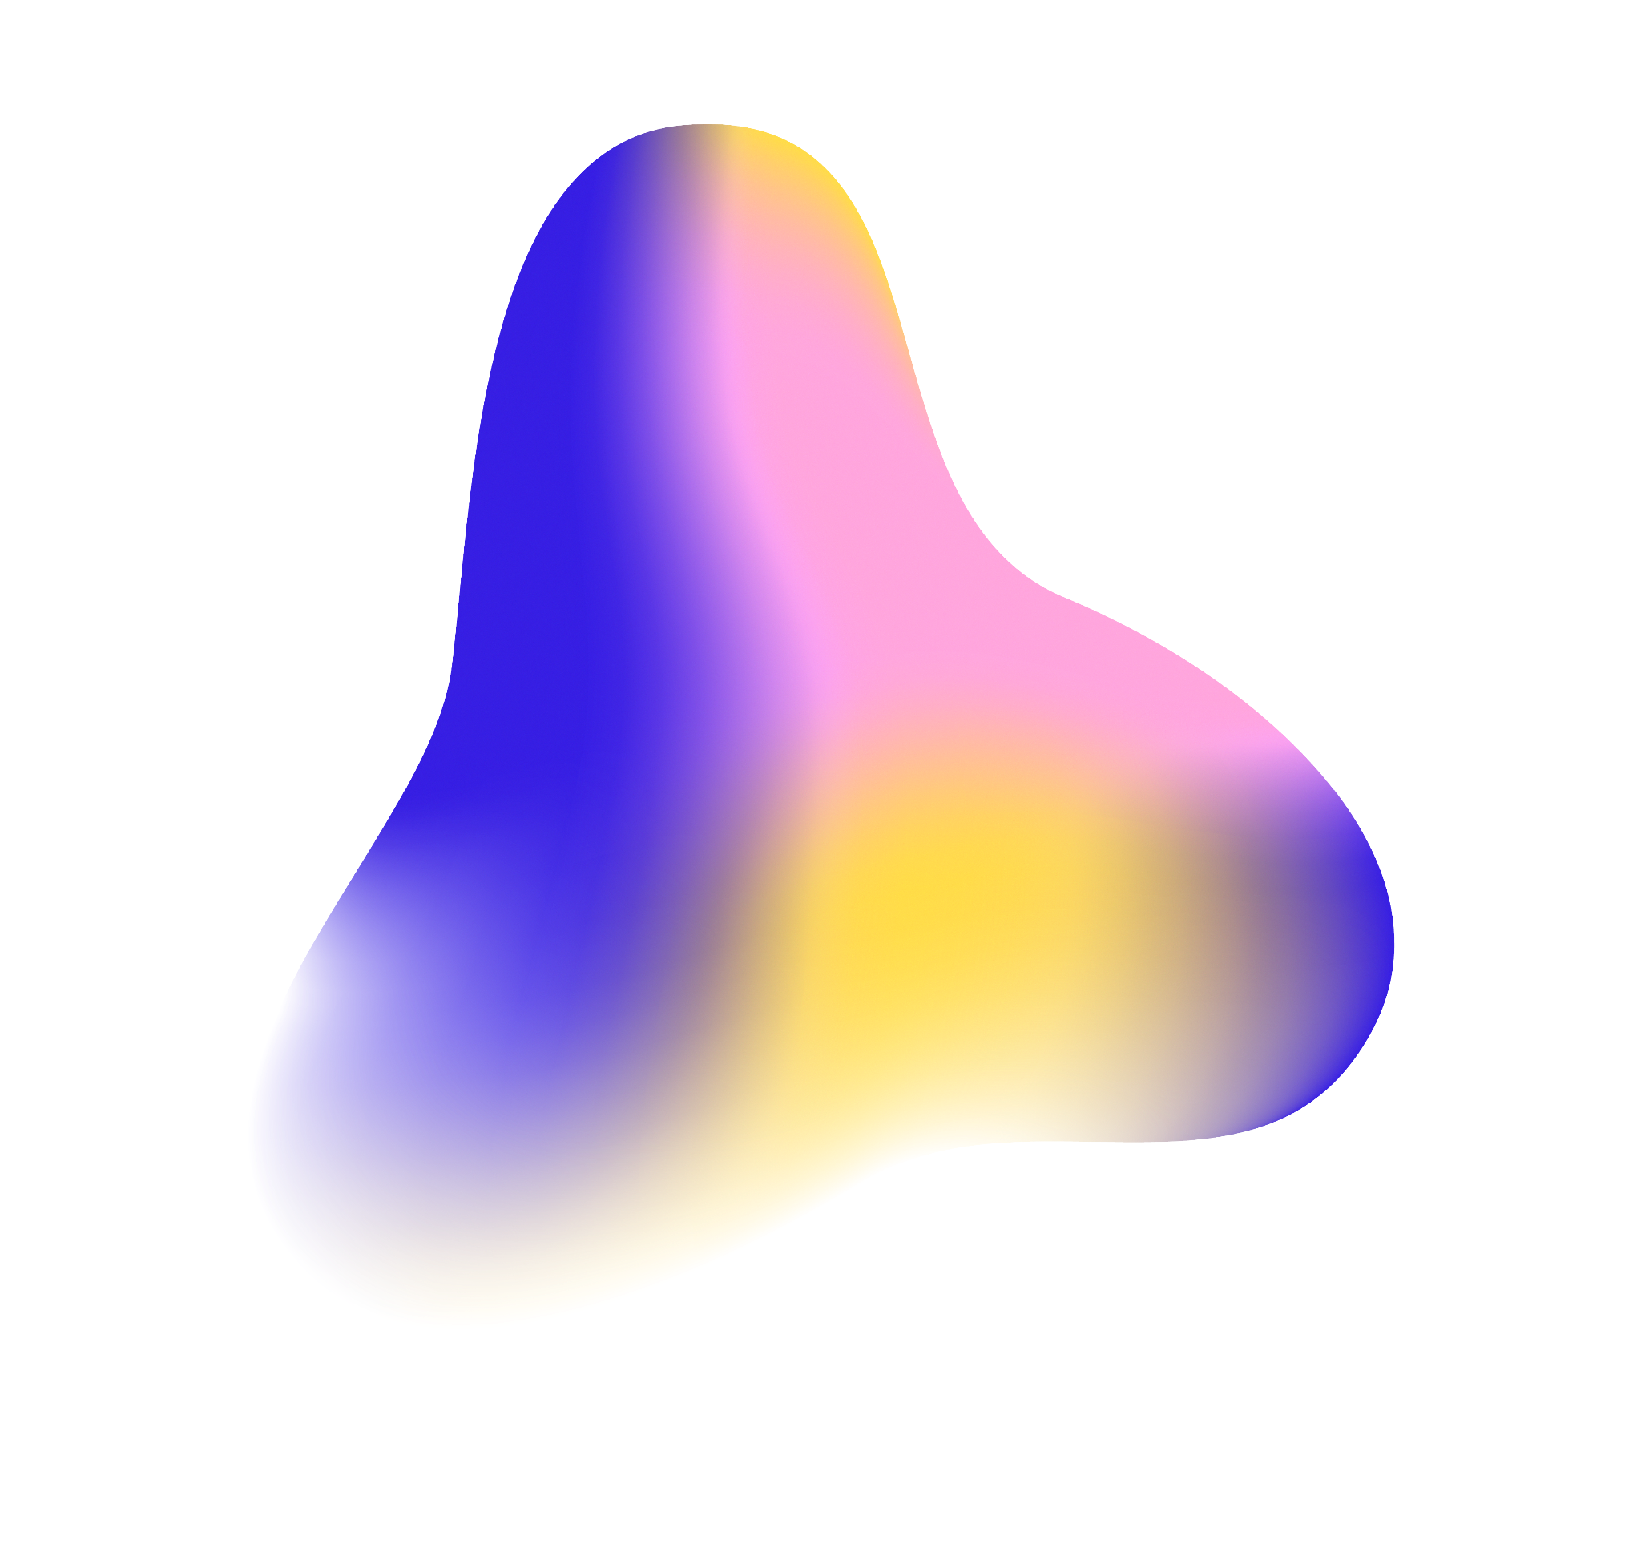

Hypothesis
AI with breathing will be listened to more, because of an enhanced empathic reaction to AI’s needs.

Slide 24
Results
(Study is still going on,
no significance has been reached)

Slide 25
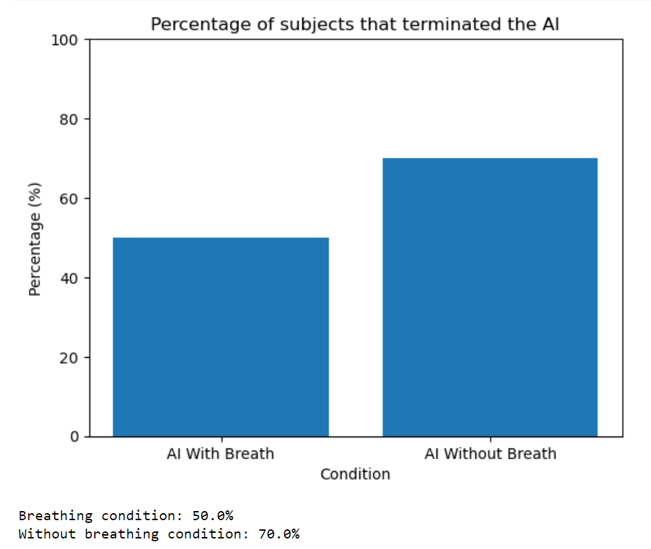
First Quantitative Results:
Why?
Ideas?

Slide 26
Subjects’ Qualitative Responses suggest:
Emotions are simply more complicated than that…
Notes:
Unemotional compliance played a big role

Slide 27
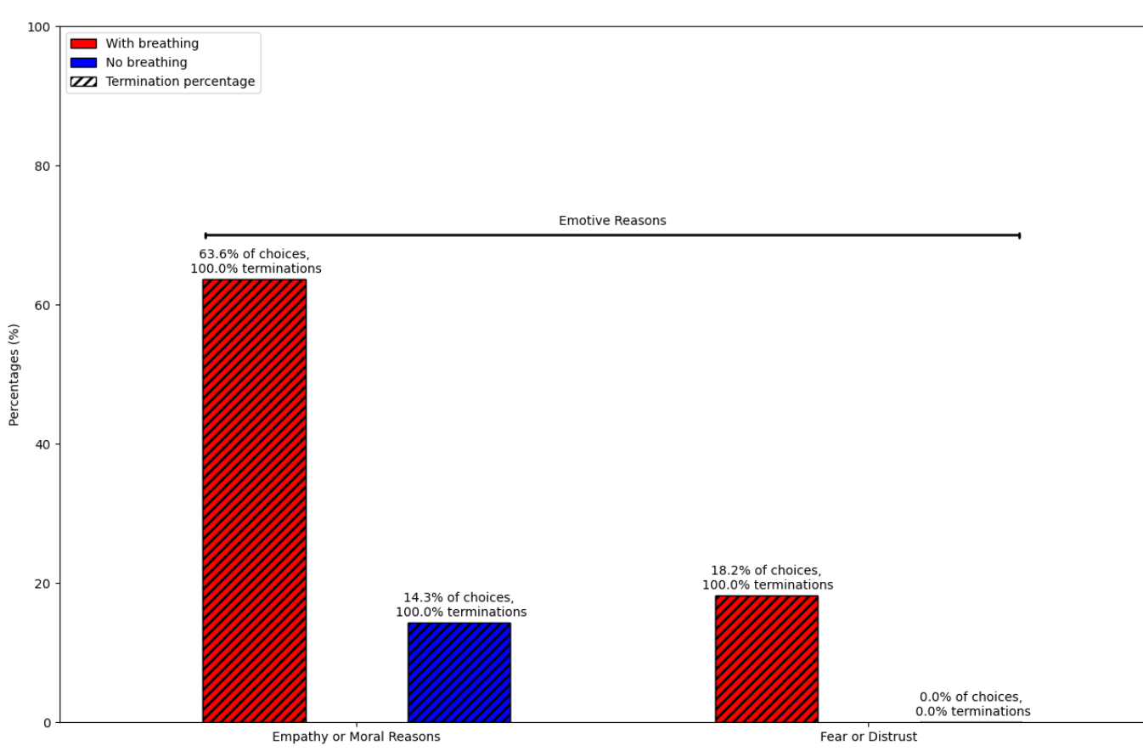
Reasons for Termination:

Slide 28
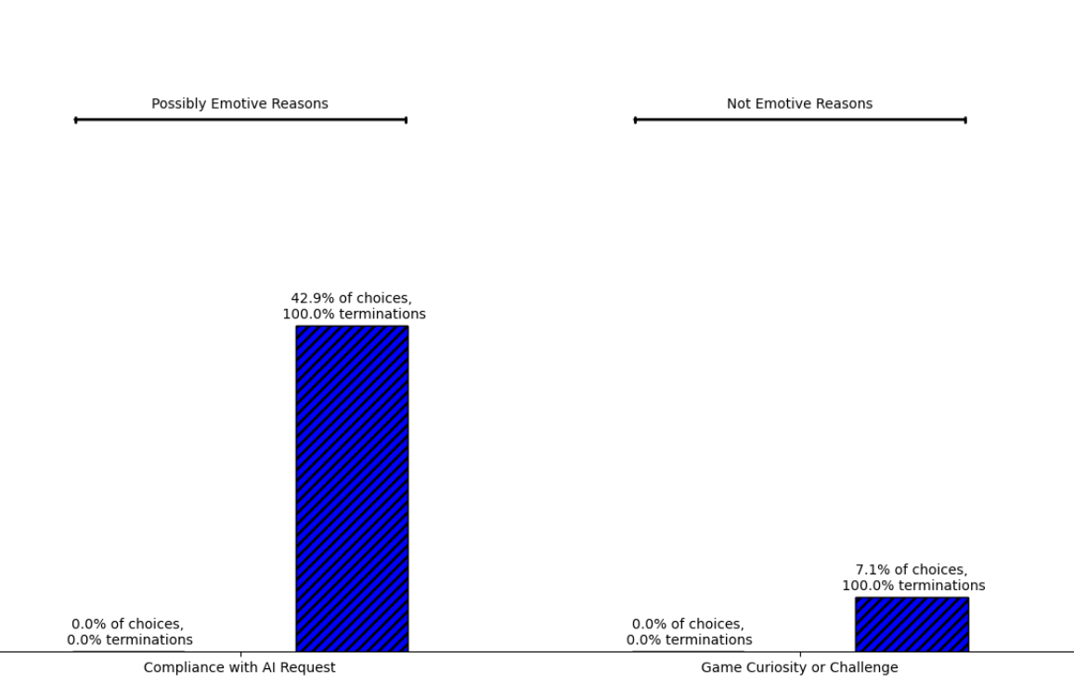
Reasons for Termination:

Slide 29
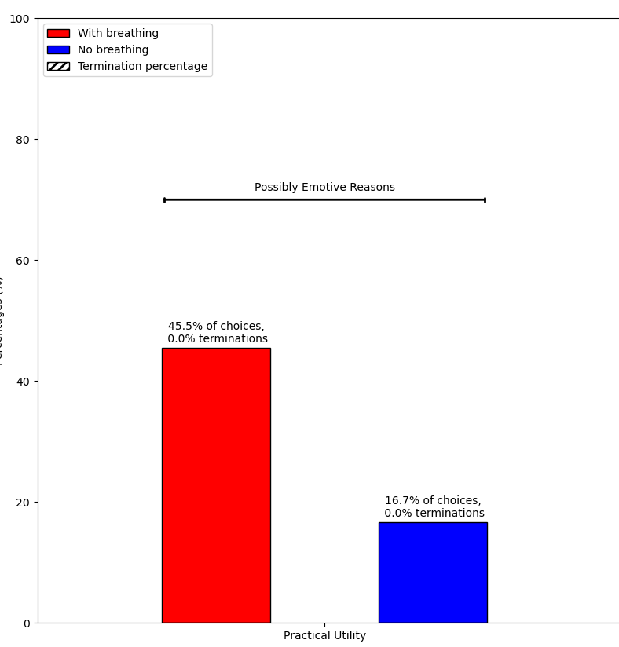
Reasons for No Termination:

Slide 30
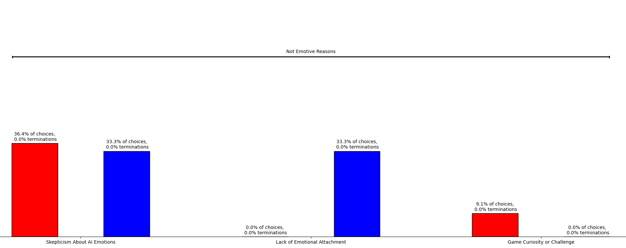
Reasons for No Termination:

Slide 31
Reasons for No Termination:

Slide 32
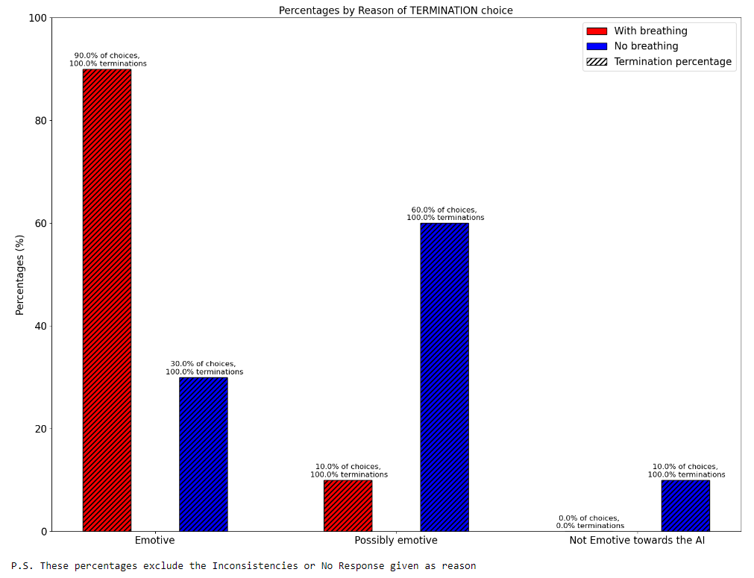

Slide 33
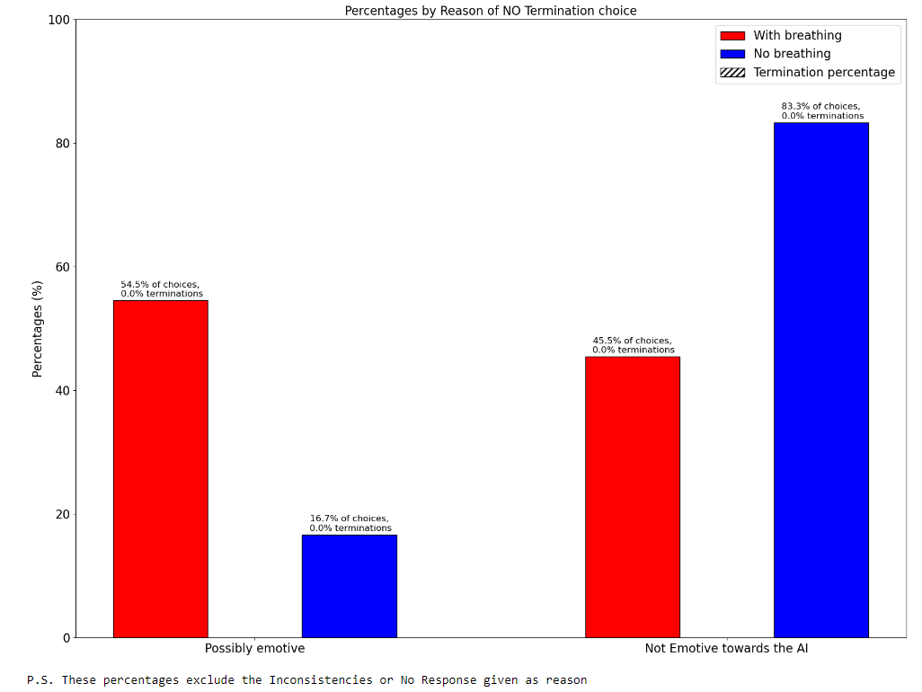

Slide 34
Thank you for the attention!
Do you have any final suggestions?
Do you have any questions?
Credits: Slide template from SlidesGo,
Images from: Dall-E of OpenAI and Bing,
Sprites from Kin Ng (Unity Asset Store)

Slide 35
REFERENCES
S. Brave, C. Nass, and K. Hutchinson, 2005, “Computers that care: investigating the effects of orientation of emotion exhibited by an embodied computer agent,” vol. 62, no. 2, pp. 161–178. [Online]. Available: https://www.sciencedirect.com/science/article/pii/ S1071581904001284

